Slide 1
“We had to make split second decisions and work as a team. The more we worked as a team the easier it was but this wasn’t a cruise around the Bay. I feel like an athlete!”
Building American Leaders Through Sailing
Corporate Programs

Slide 2
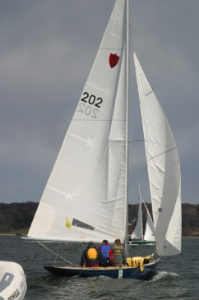
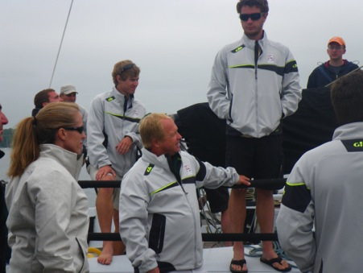
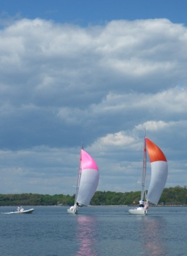
Oakcliff Forms Your Team Through Sail
“We were out of our comfort zone, got to know our colleagues very quickly, all in a fun learning environment.”
Sailing is a rather rarified sport. The beauty of this neutralizing platform is that your teams will start the day with the decks cleared, everyone equally tentative, ready to discover new strengths, to overcome weaknesses and to build towards a strong and vibrant future.
No other sport offers such an ideal platform for corporate and group training and team building.
Oakcliff trains corporate groups from 5 to 75. Using fleets of vessels ranging from 30 to 50 feet in length Oakcliff’s customized programs run from 2 hours to 2 days. The myriad of options ensure that your experience will deliver long lasting positive effects on your group.

Slide 3
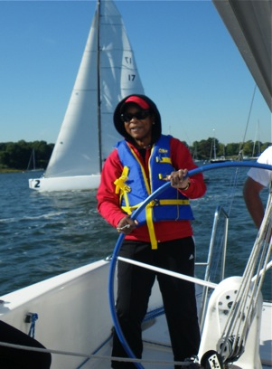
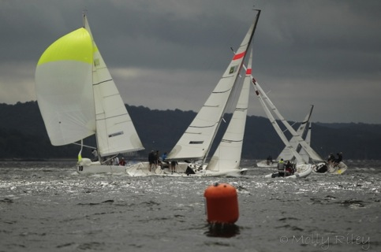
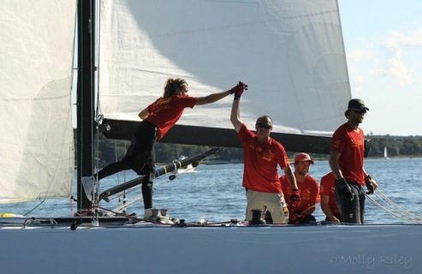
Push the Limits of Nature
“I learned about sailing; keeping a eye on the boat and our course as well as the competition. Much like business”
It is not all polished varnish and cotton sails, sailing is intense. Participants are pushed to harness the forces of nature to propel their boats around the course and to the finish line.
Oakcliff’s Match 40s are the perfect boat allowing participants to test their limits and operate the boat as a newly configured team. Coaches are near for safety purposes but you and your crew are running the ship and deciding the course your team will take.
Participants will actively work through calculated risk taking, problem solving, group decision making, communication and build to trust and success. Everyone ends up a winner.

Slide 4
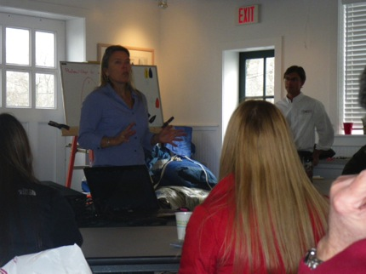
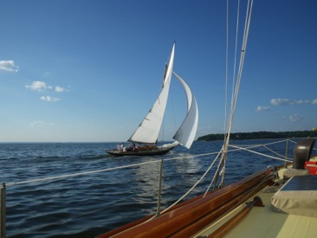
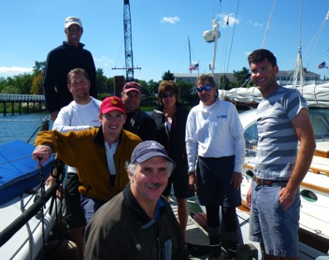
As Casual or Facilitated as Your Winds Dictate
“Dawn and the team were great and very flexible in accommodating our group to maximize the experience.”
Oakcliff has on-site coaches experienced in team building, corporate presentations and facilitation. We also believe that the sheer experience of forming a team and navigating around the bay can have lasting positive impact on each individual and on the organization as a whole.
You tell us – Casual or Formal? Happy accident or Facilitated? We’ll customize each program for you.

Slide 5
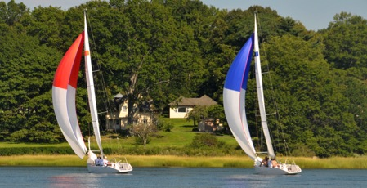
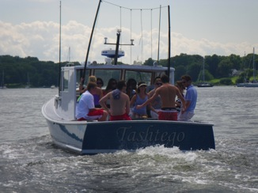
Sailing is Social
“What a fun day with the team! A lot of laughs and a lot of joint learning. I think everyone got a great introduction to sailing. And we had fun doing it.”
Every program allows plenty of time for casual, out of the boardroom interactions. For those groups looking to capitalize on the social activities, Oakcliff has beautiful yachts and launches for casual cruises. After sailing dining activities range from a unique al fresco dining experience to formal sit downs at a local restaurant or even a castle.
Social Program Schedule:
  3:00 Arrival at Oakcliff (20miles from NYC)
  3:30 Walk to the boats and learn the ropes
  4:00 Sail or cruise around the Gatsby-esque Oyster Bay
  6:00 Return to the quaint clubhouse for social activities, mingling and entertainment or travel to a formal dinner.

Slide 6
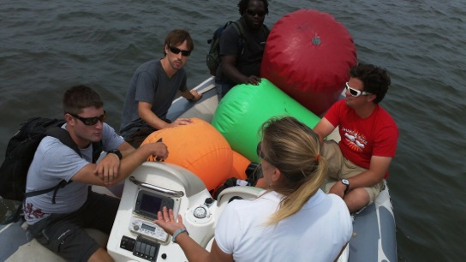
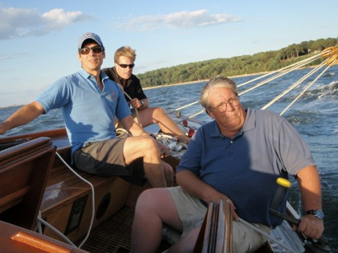
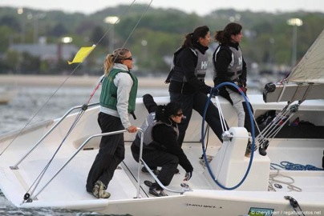
Teams Working Together
“I was with a team of people I don’t often work with. We came together under stress, learned to sail and saw success.”
Oakcliff will work with your group to fit your schedule and your needs but there is one thing about sailing – if you don’t work as a team, you go nowhere.
Teams Working Together Schedule:
12:00 Arrive for lunch and team forming
1:30 Work with your individual coaches to set goals and chart your team’s course.
2:00 Sail with your team learning each role onboard & discover how they form the whole.
4:00 A short race where teamwork is the key to winning.
5:30 Reform as a whole over a snack and a drink refreshed to go forward as a team.

Slide 7
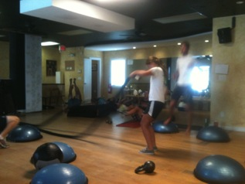
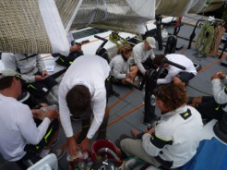
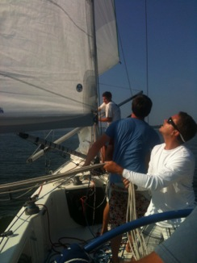
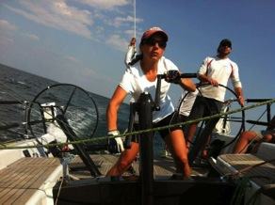
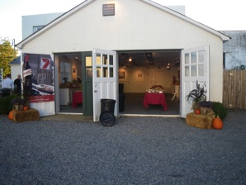
Full Immersion
“The Best: Realizing I could do it!!!!”
Does your small group want the full experience? Do you want to be a part of the team? Work hard? Feel what it is like to be a top athlete? Test yourself against nature? Check out this exclusive program reserved for prequalified individuals:
Full Immersion Schedule:
7:30 Work out with the team & expert Steve Gourlay
9:00 Shower at your hotel
9:30 Hearty & Healthy Breakfast with the team
10:00 Team meeting – learn your tasks for the day
11:00 To the boats – morning training of, tacking, grinding, tailing, steering, jibing. Don’t know these words? You will!
1:00 Sandwiches on shore and morning debrief. Challenges? Successes? Shared lessons? How does this relate to every-day life?
2:00 Back on the water – time to race! Take no prisoners full on sailing
4:00 Pitch in – put the boats away and head to the event space
5:00 Debrief - lessons learned – continuing new attitudes tomorrow
6:00 Awards Party
9:00 A good night’s sleep is guaranteed

Slide 8
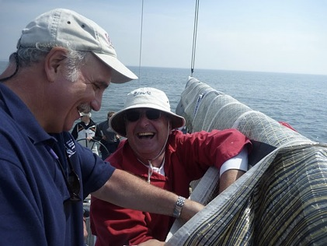
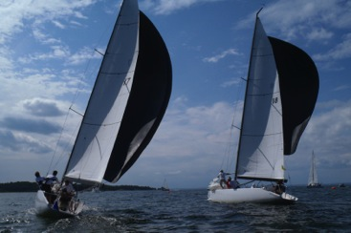
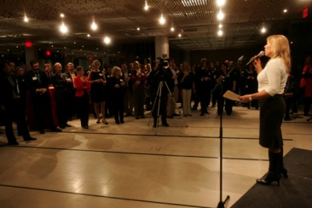
More than Sailing – It’s Business
“At Oakcliff we quickly were gelling into a team with peer alpha-leaders from across our global company”
Sailing, Golf and Tennis – business gets done, deals are made but you need to know the basics. Allow Oakcliff to train you in the sports of business. Let Oakcliff give you the skills to close the next deal.
This multi-day event is an investment in your future:
  Half Day of sailing each day with top athletes
  Half Day of Golf at one of the most exclusive courses in NY
  Half Day of Tennis with private coaching
Evening talk with renowned business speakers
Dinner and Drinks with coach transfer
Accommodation at the all suites Fox Hollow Inn

Slide 9
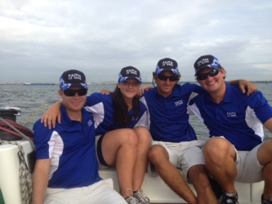
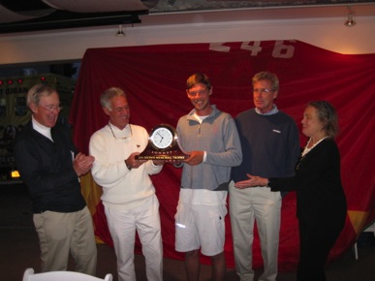
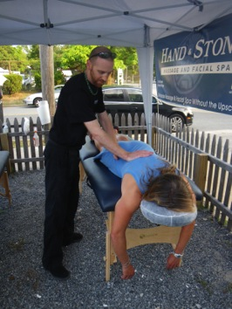
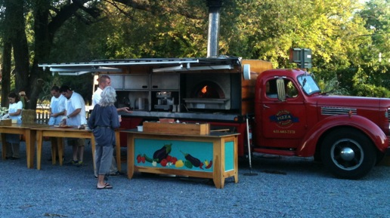
Add Ons
“Thank you again for a totally awesome experience. I can now cross learning how to sail off of my Bucket List! ”
Every program is fully customizable and can include:
  Team Uniforms: Caps to Technical Gear by Gill
  Trophies and Medals
  Meals from Casual to Elegant
  Live Music from Sea Shanties to Motown
  After Sailing Massages alfresco

Slide 10
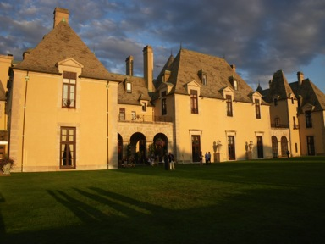
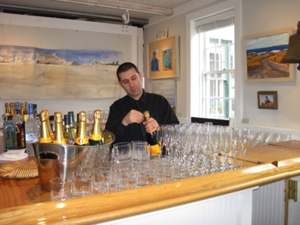
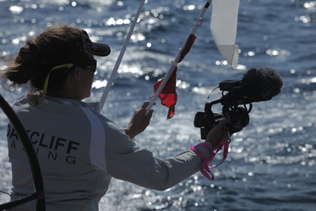
Add Ons Continued
“Great day yesterday. The match 40 are terrific. What fun. I have uploaded 28 photos to my website.”
  Overnight Accommodations: Basic to Oheka Castle
  Transfers to the City
  Traditional Ropes activities
  Video and Photography
  Meeting Rooms and AV Equipment
  Other Entertainment
  Historical and Wine Tours

Slide 11
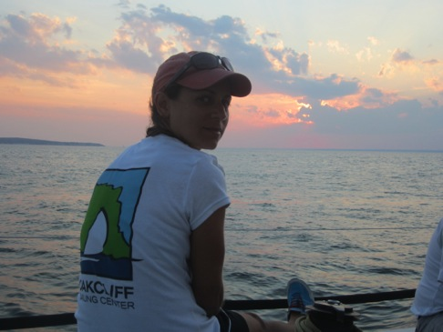
Pricing:
You’ll look back at Oakcliff as life -changing
  All pricing will be customized to suit
  To schedule your event please call: 516 802 0368 or email race@oakcliffsailing.org

